Slide 1

PREDICTION OF RHEUMATOID ARTHRITIS SEVERITY USING BIOMARKERS AND BLOCKCHAIN
24AIM112 Molecular biology and basic cellular physiology
24AIM115 Ethics, innovative research, businesses & IPR
K. Nitya - CB.AI.U4AIM24123
B. Pavani Shreeya - CB.AI.U4AIM24106
Ardhra Vinod - CB.AI.U4AIM24105
Harikrishna Sivanand Iyer - CB.AI.U4AIM24114

Slide 2
Overview of Review 1
Autoimmune diseases, such as rheumatoid arthritis (RA) involve multiple biomarkers like cytokines and immune cell markers. RA diagnosis and treatment strategies often depend on subjective clinical evaluations which leads to delay in treatment. So, there’s a need to develop a model to predict severity of RA and also to recommend treatment strategies.
To develop a Graphical User Interface (GUI) which allows the users to input the biomarker levels which can predict the severity of RA using Multi Layer Perceptron (MLP) and recommend treatments. We will be integrating Blockchain technology in our project for data privacy.
Dataset was acquired from the NCBI’s Gene Expression Omnibus(GEO).
Preprocessing was done using MinMaxScaler.

Slide 3
XGBoost Algorithm
XGBoost is an optimized implementation of Gradient Boosting and is a type of ensemble learning method. Ensemble learning combines multiple weak models to form a stronger model.
It uses decision trees as its base learners combining them sequentially to improve the model’s performance. Each new tree is trained to correct the errors made by the previous tree and this process is called boosting.
Methodology
Raw biomarker data was converted into meaningful levels using logarithmic transformations.
Classification of RA severity was done by setting pre-defined conditional statements
These threshold values were taken from Research paper.

Slide 4
- If TNF-Alpha > 10 and IL-6 > 40, the severity is classified as "Severe".
- If TNF-Alpha > 5 and IL-6 > 10, the severity is classified as "Moderate".
- Otherwise, the severity is classified as "Mild".
- Severity labels were created in a separate column.
- The severity labels were mapped to different classes ("Mild" → 0, "Moderate" → 1, "Severe" → 2).
- These biomarker values were normalized using MinMax scaling.
- Data was split into train (80%) and test (20%) sets.
- Model was trained with XGBoost algorithm and evaluated using Log loss.

Slide 5
Building GUI
Using Tkinter in python we built the Graphical User Interface (GUI) for entering biomarker levels(5) and get prediction using the trained model.
Tkinter is a standard GUI library for Python which provides a fast and easy way to create desktop applications.
The pre-trained model was loaded for making predictions.
The application window was given a sky blue background.
5 Input fields were created and a “prediction severity” button was added to get prediction.
This GUI takes input biomarker levels, scales them, makes a prediction and displays the result.
This GUI is useful for lab researchers, clinicians and doctors to analyze patients with RA severity.

Slide 6
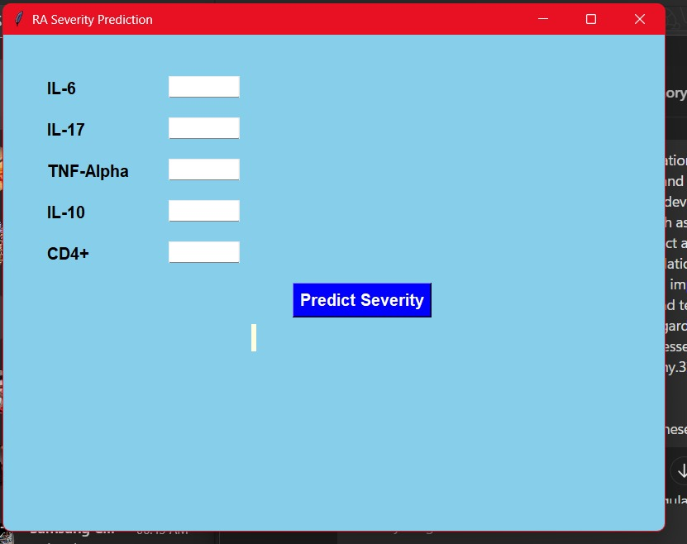
GUI Window

Slide 7
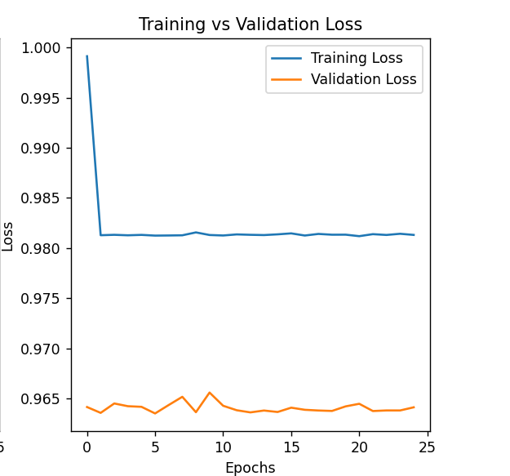
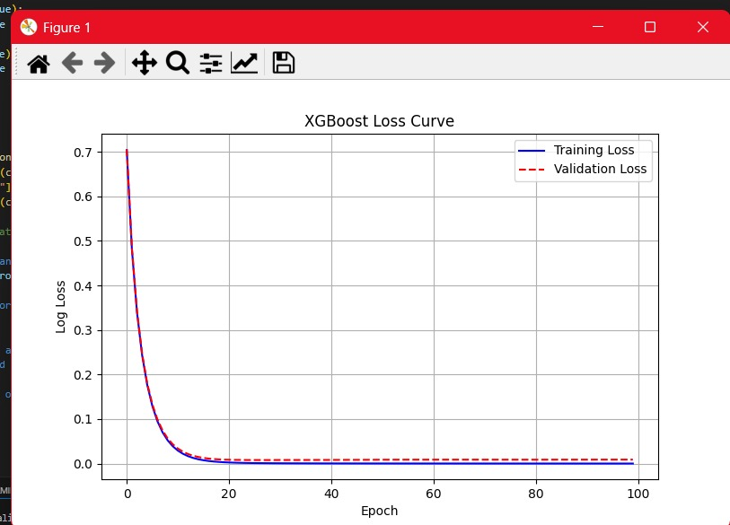
Comparison Study
XGBoost MLP

Slide 8
Artificial intelligence in rheumatoid arthritis: potential applications and future implications
AI models can be trained to analyze and interpret patient data, including physician notes, laboratory testing, and imaging, to aid in the management of patients with rheumatic diseases.
Deep learning is a more potent tool, especially effective when working with complex data such as images, audio, and natural language.
A primary obstacle is the limited access to healthcare data for training and testing models, which is largely due to the confidential nature of patient records.
Like other aspects of healthcare, AI tools will need to be subject to high levels of regulation before we see widespread adoption. Several efforts have been made in this direction by both American and European regulatory agencies.
The FDA recently issued the ‘AI/ML-Based Software as a Medical Device (SaMD) Action Plan,’ which supports the development of methodologies for the evaluation and improvement of AI algorithms.

Slide 9
Transforming Rheumatoid Arthritis Management: Harnessing Artificial
Intelligence for Early Detection, Personalized Treatment, and Ethical
Challenges
Artificial intelligence has progressed into using genetic and biomarker information and predicting potential biomarkers that leads to development of RA personalized drugs.
Machine learning algorithms can analyze large datasets of biological samples from RA and can be used to tailor treatment strategies to individual patients, improving the efficacy of therapies.
The development and deployment of AI in the management of RA can support a goal that all patients should be assured of high-quality, fairly administered, and transparently accounted care.
artificial intelligence systems may easily become more transparent in making decisions, and the reasons behind these decisions are therefore more understandable and human interpretable.

Slide 10
Advancements in machine learning and AI in rheumatoid arthritis
ML algorithms are applications of AI that excel at integrating heterogeneous data sources and uncovering hidden patterns and relationships within complex datasets.
These approaches offer promising tools to address myriad challenges by analysing large and diverse datasets to aid diagnosis and screening, predict treatment responses, and personalise patient care in RA. The technology also displays potential in the field of drug discovery.
Ethical considerations, privacy concerns, and regulatory requirements surrounding data sharing and algorithm deployment pose additional challenges to the implementation of ML approaches in clinical practice.

Slide 11
On the Integration of Artificial Intelligence and Blockchain Technology: A Perspective About Security
AI is a multidisciplinary field that draws from various areas including machine learning, deep learning, natural language processing, and robotics.
The principal characteristic of Blockchain is its decentralized nature, removing the need for a central authority or intermediary.
The immutability feature in blockchain is one of the key security advantages of Blockchain technology.
AI techniques that utilize Blockchain can offer decentralized learning to facilitate a trust and secure sharing of knowledge and decision outcomes

